Slide 1
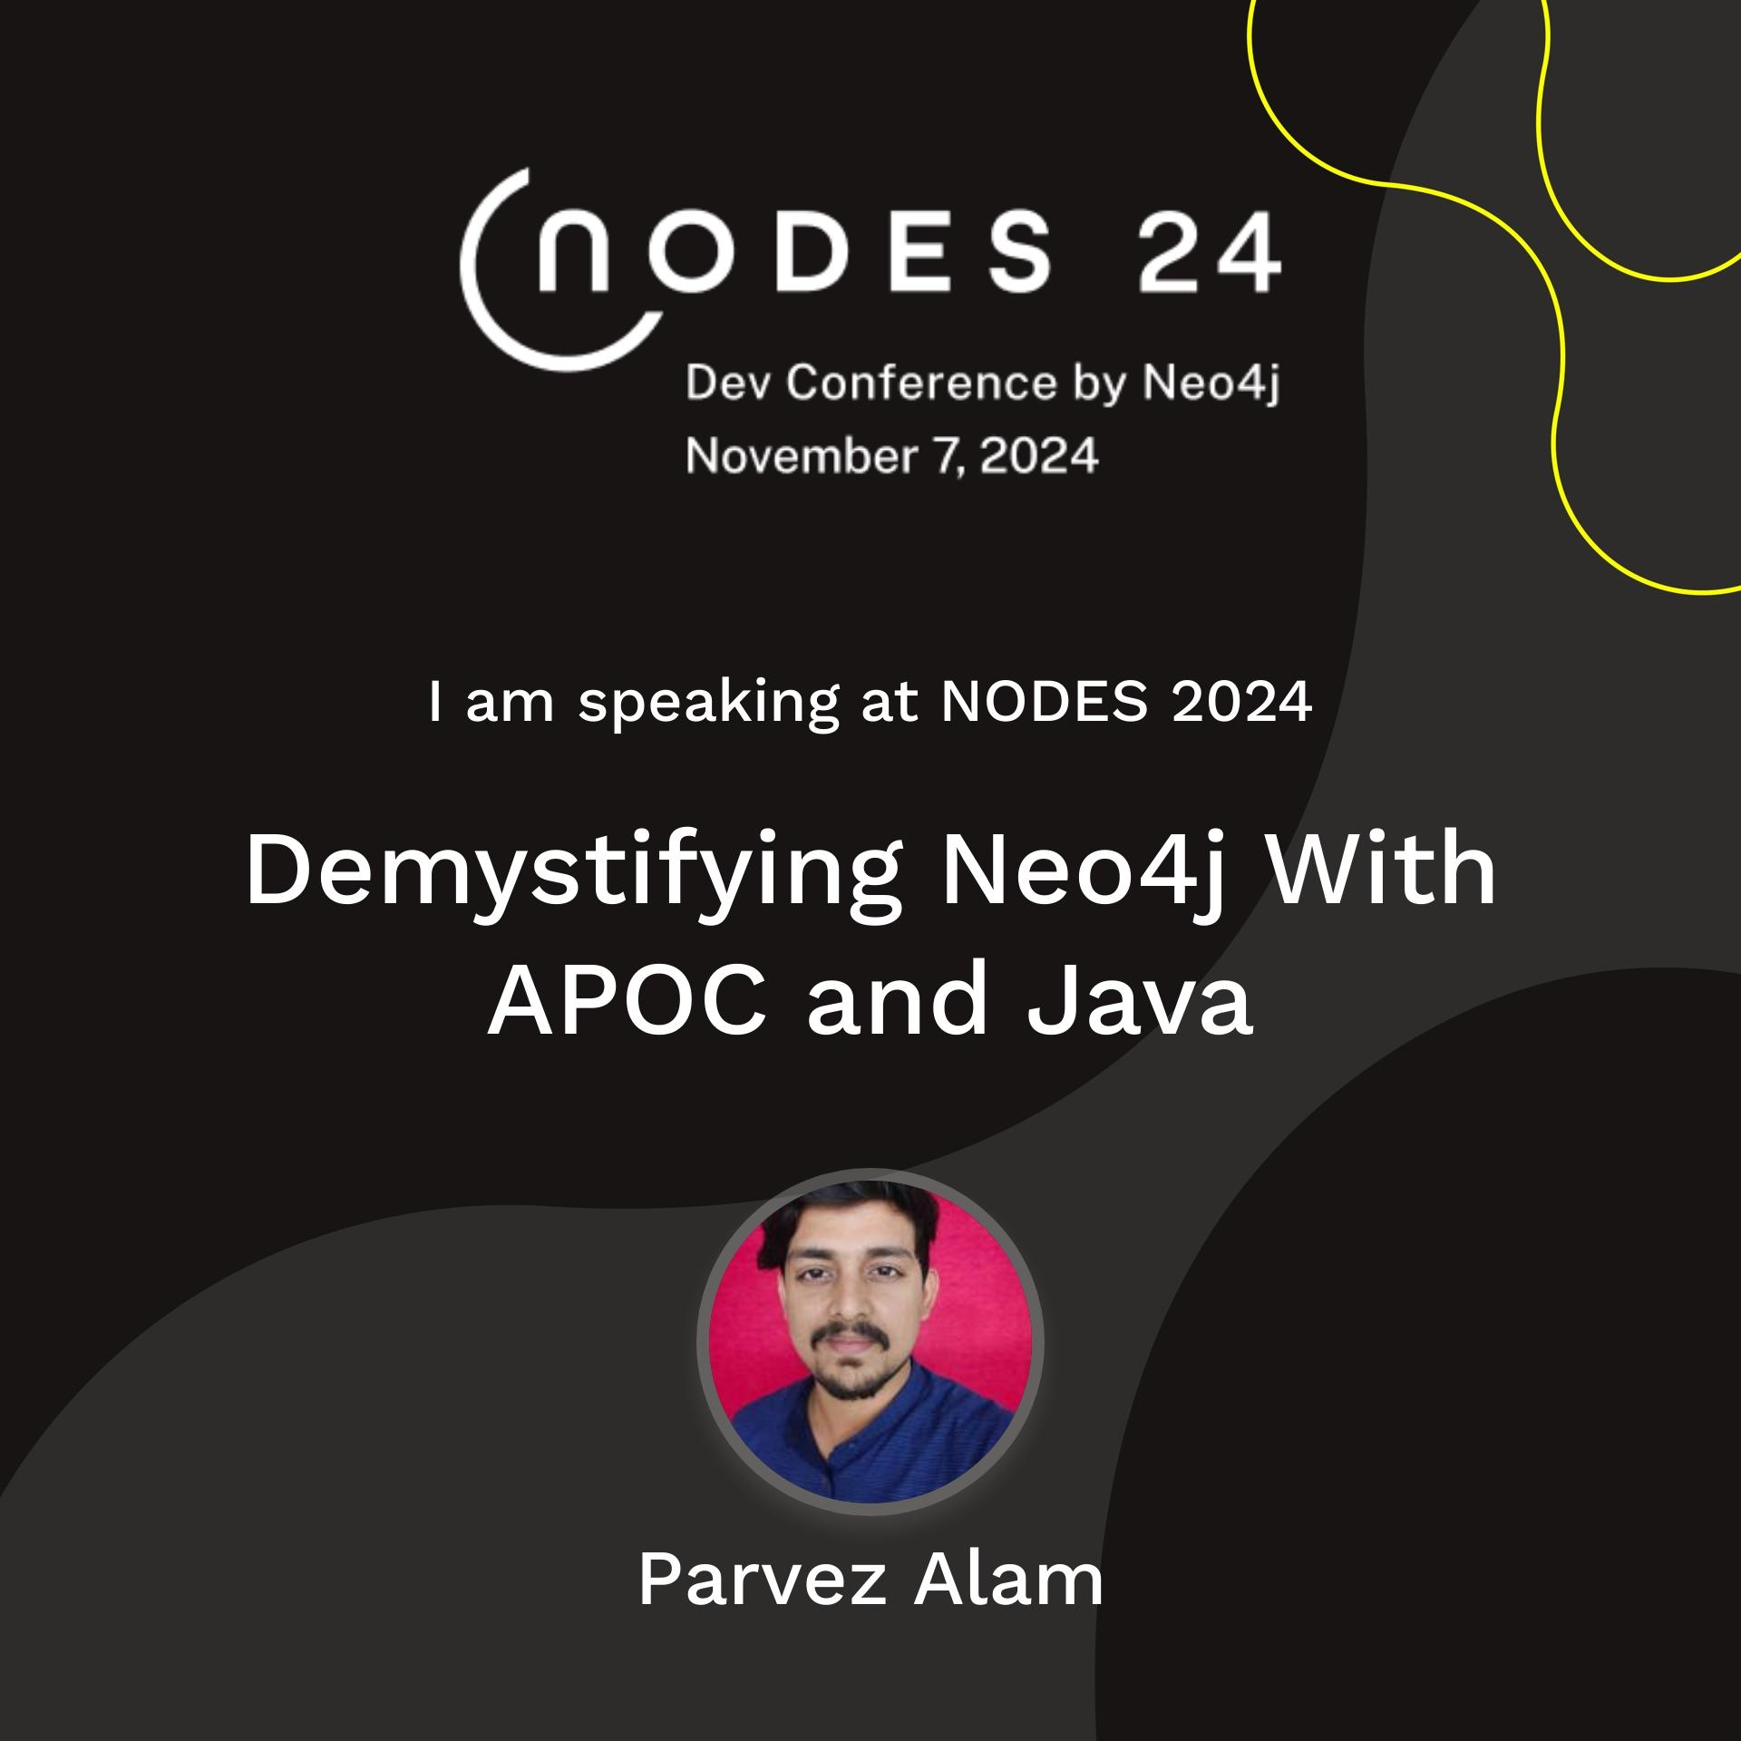
Software Developer, SIEMENS

Slide 2
AGENDA
Configs for APOC
Handle UNWIND scenarios
Problems with Multiple Records for Single Entity
WRITE & READ Operations
@Transactional Effects with Java
PROFILE your query
Why Avoid APOC *

Slide 3
APOC CONFIGS
Basic APOC Plugin: From Dashboard
For Extended APOC Plugin: https://github.com/neo4j-contrib/neo4j-apoc-procedures/releases
Conf File for APOC
apoc.conf => C:\Users\userName\.Neo4jDesktop\relate-data\dbmss\dbms-name\conf\apoc.conf
Don’t start the DB until you complete these steps
For Best practices

Slide 4
Handle UNWIND Scenarios

Slide 5
Problems with Multiple Records for Single Entity

Slide 6
WRITE & READ Operations

Slide 7
@Transactional Effects with Java

Slide 8
PROFILE your query

Slide 9
Why Avoid APOC *

Slide 10
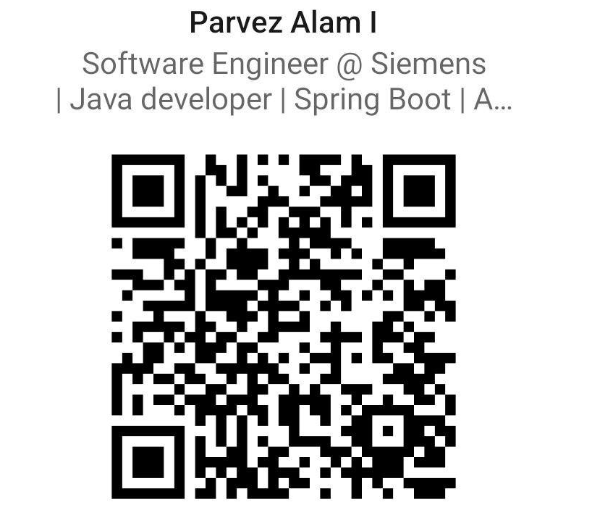
Thanks
Questions ?
Code and Slides : https://github.com/Parvezi123/coffeecode
LinkedIn: https://www.linkedin.com/in/imparvez/

